Slide 1
Using CReSIS Radar Data to Determine Ice Thickness and Surface Elevation at Pine Island Glacier
Team Members:
Nyema Barmore
Glenn Michael Koch
Team Mentors:
Dr. Sridhar Anandakrishnan
Mr. Peter Burkett

Slide 2
Penn State Team Members
Glenn Michael Koch
Elizabeth City State University
Nyema Barmore
Elizabeth City State University

Slide 3
Team Mentors
Dr. Sridhar Anandakrishnan
Penn State University
Mr. Peter Burkett
Penn State University

Slide 4
Overview
Abstract
Keywords
Methodology
Conclusion
Future Work

Slide 5
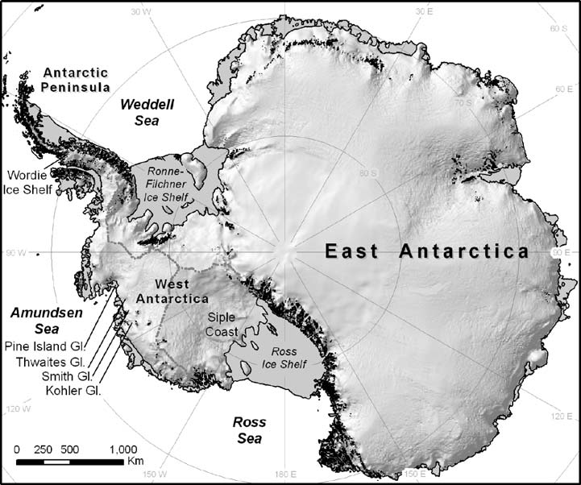
Study Area
Pine Island Bay
(100° West Longitude - 112° West Longitude)

Slide 6
Abstract
The Pine Island Glacier region of Antarctica is an area under intense scrutiny because of its sensitivity to climate change. Pine Island Glacier is located in Western Antarctica and drains a large portion of the West Antarctic Ice Sheet. It has shown to be particularly vulnerable to glacial ablation [1]. The 2012 Research Experience for Undergraduates (REU), Ocean Marine Polar Science (OMPS), Penn State Team analyzed CReSIS radar data to identify the ice-surface and ice-bottom features. From this, both elevation and ice thickness at Pine Island Glacier were determined. The team utilized MATLAB along with an add-on picker program; The Penn State Environment for Seismic Processing (PSESP), developed at Pennsylvania State University. MATLAB is a programming environment that analyzes data as well as many other technical processing applications. With the picker program the team selected specific, maximum-strength radar peaks on individual radar traces and applied a formula to compute the distance traveled by the signal. The difference between the distance traveled from the surface and bottom features was calculated to produce an ice thickness map. The team results will provide data that will aid in modeling of the Pine Island Glacier.

Slide 7
Keywords
Glacier
Radar
Refractive Index
Mass Balance
Calving
Ice-sheet
Topography
Echogram
Picker Program

Slide 8
Methodology
Downloaded radar data files
Downloaded PSESP

Slide 9
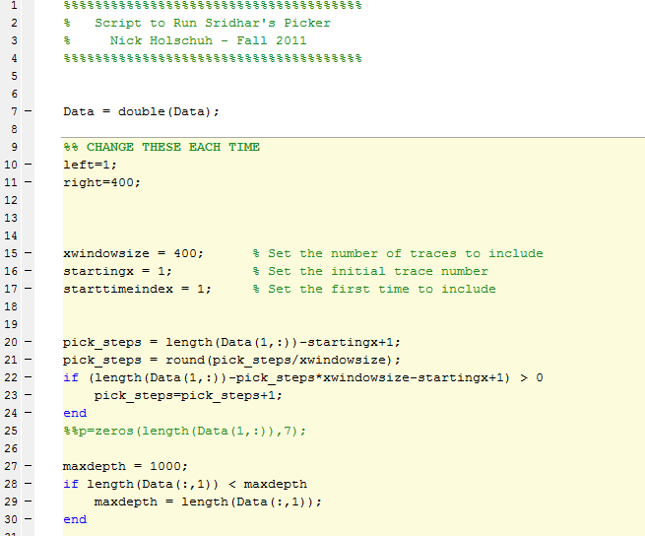
Initiate_Pick_REU.m

Slide 10
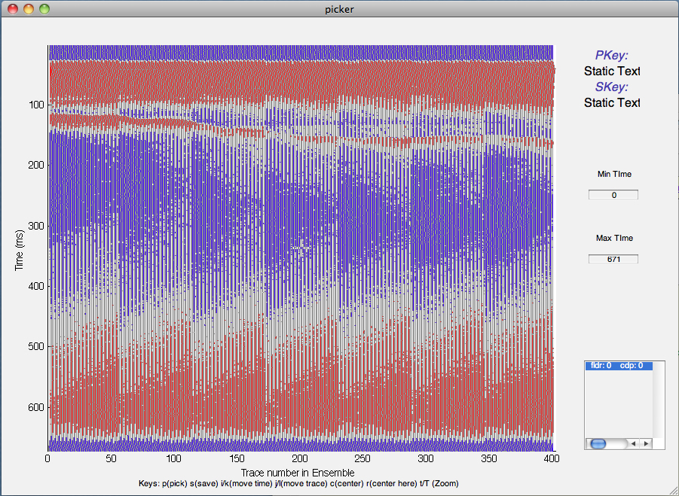
Data Panel

Slide 11
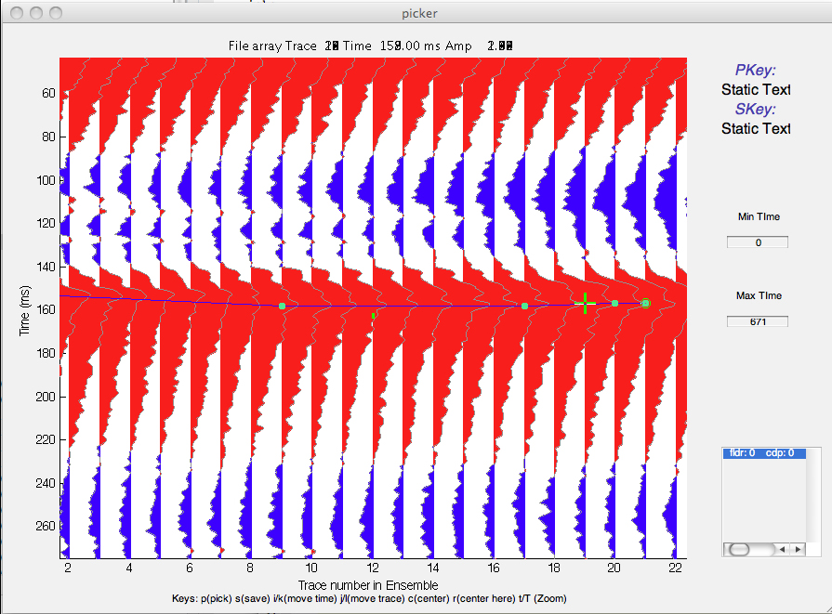
Manual Picked Point

Slide 12
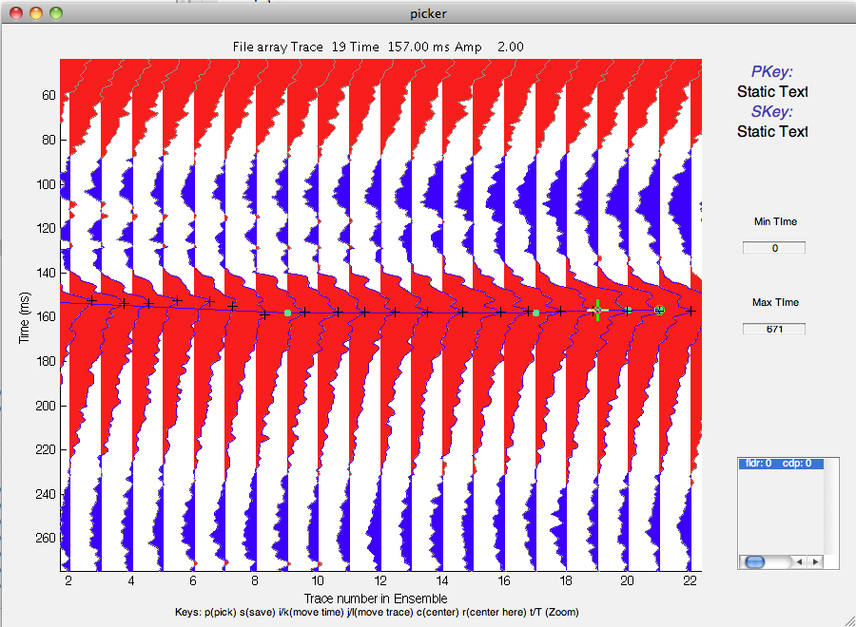
Automatic Program Selected

Slide 13
Flight Path With Single Pass Highlighted

Slide 14
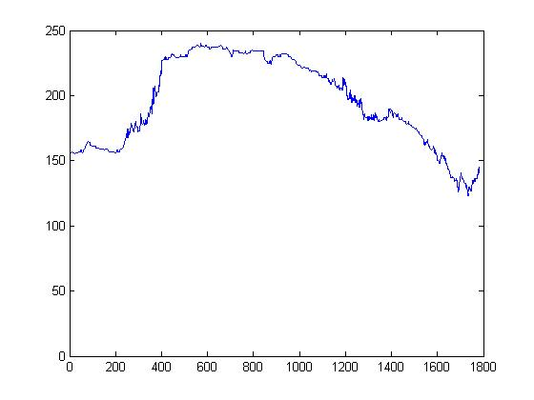
Plotted Data Bottom Surface

Slide 15
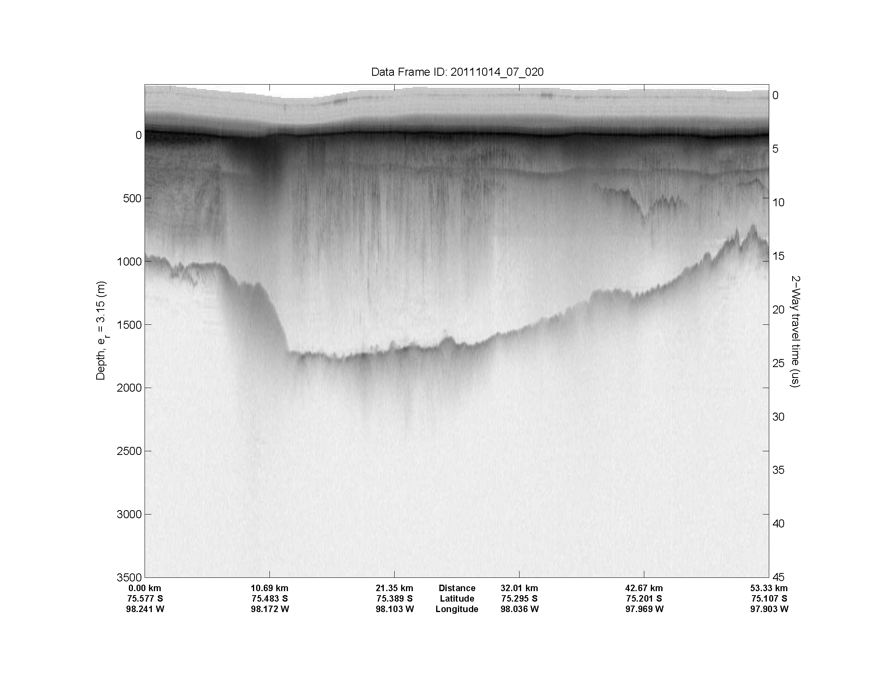
CReSIS Echogram Snapshot

Slide 16
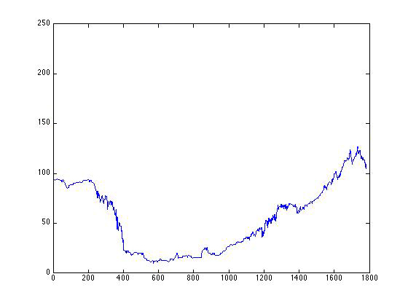
Plotted Data Bottom Surface
Flipped

Slide 17
Ice Thickness Calculation:
[(((Bottom horizon – surface horizon) /10)/2)*170m/uS]
Step 1: Take the picker difference value of time between the bottom and surface. Step 2: Divide by 10. This converts it from "samples" to real time (in micro seconds). Step 3: Divide that time by 2. This converts the "two way" travel time (going from the plane to the bottom of the ice and back to plane) into a one way travel time (from the plane to the bottom of the ice). Step 4: Multiply that number by 170 (which converts time to distance because radar waves travel at 170 meters/uS in ice).

Slide 18
Conclusion
Analysis provided numerical elevation data from CReSIS radar data sets that could be plotted and compared to echogram images
Some data sets provide difficulty in human analysis
Data plots did correlate to echogram snapshot images
Data plots provided a reliable source to perform ice thickness calculations

Slide 19
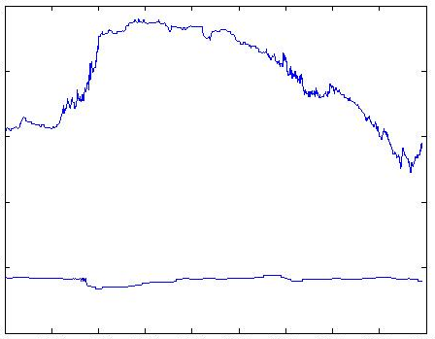
Plotted Bottom and Surface

Slide 20
Future Works
Continued Analysis of Data Sets
3D model
PSESP program modification
Possible combining optical character recognition with PSESP
Option to plot image with the ice surface at the top and bedrock at the bottom

Slide 21
Questions?

